Slide 1




SCOPUS and SciVal
Evaluation and Promotion of
Ukrainian research results
Piotr Gołkiewicz
Product Sales Manager, Central and Eastern Europe
Lviv, 11 September 2013

Slide 2
The evolution of Ukrainian research productivity & output
Article usage correlated with article output
Complete international article access correlates with higher article output
Articles Published per year on Scopus per 1000 Researchers
Journal usage per year on ScienceDirect per 1000 Researchers

Slide 3
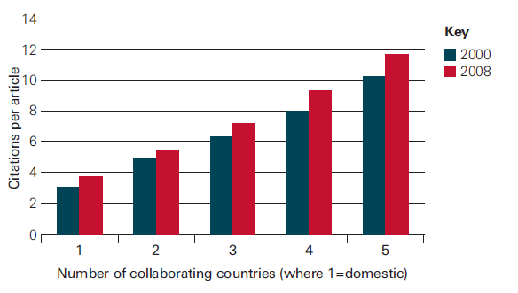
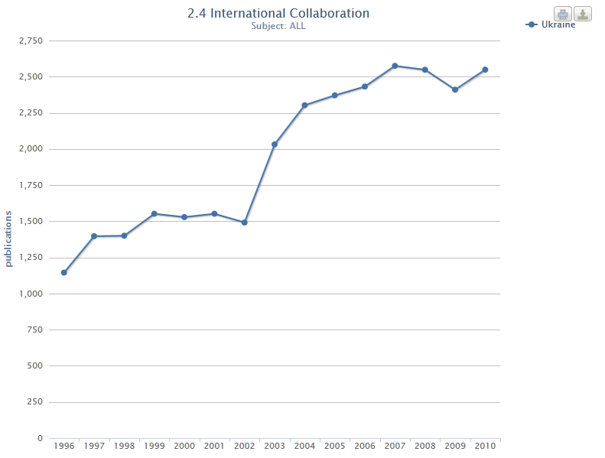
International collaboration leads to higher quality research
Effective collaboration requires complete access to international papers
- In citation terms, research collaboration is beneficial. For each international author on an article, there is a corresponding increase in the impact of that paper
- In research leading nations with which Ukraine is building collaborative relationships, international collaboration has been growing based on increasing number of international authors on national papers
# of inter. co-authors on papers
Source: The Royal Society, United Kingdom, 2011
Source: BIS study 2011, Scopus Data

Slide 4
What is Scopus?
The largest abstract and citation database of peer-reviewed research literature and quality web sources.
More than 20,000 titles from more than 5,000 international publishers worldwide
Over 47 million records, 23 million patents from 5 patent offices worldwide
Scopus also offers full integration of the scientific web in its search results with: 435 million scientific web pages (Scirus)
Modern „Discovery tools” – Author and Affiliation search, Author Analyzer, Journal Analyzer, Citations Tracking etc

Slide 5
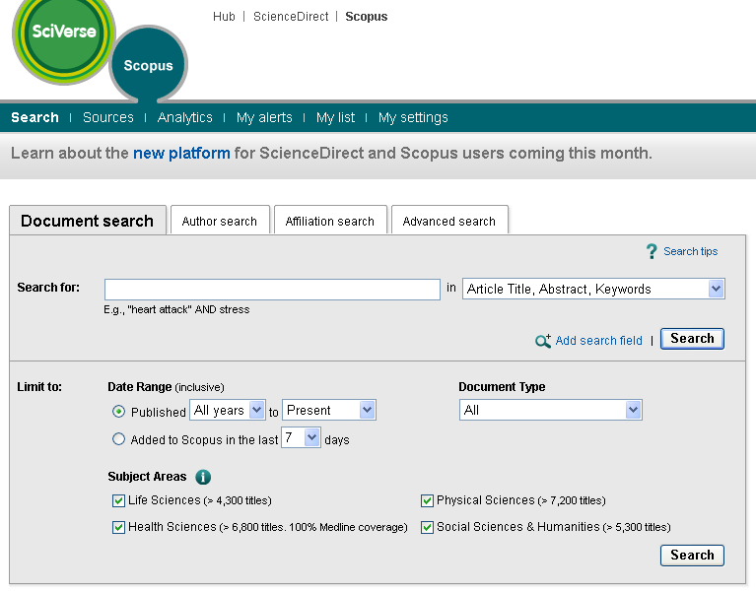
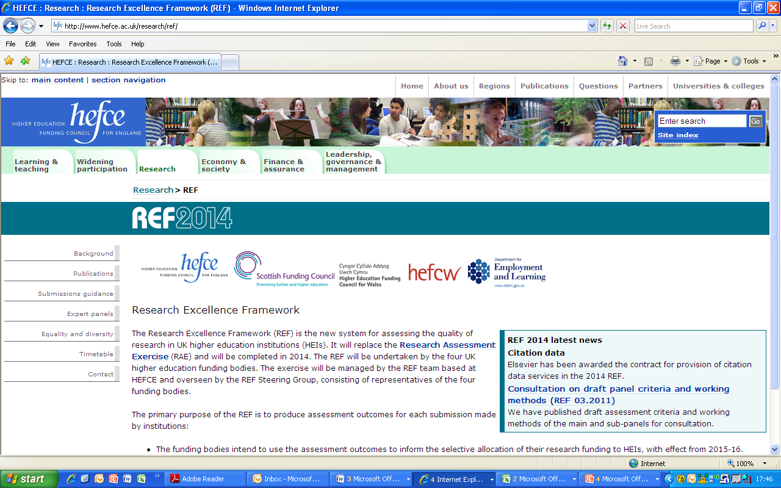
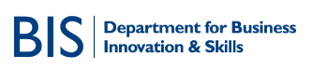











Example of users of Scopus data

Slide 6
Why Scopus?
Track Research trends – focus your resources
  FIND (GET LINK) TO FULL TEXT
Find best journals to publish – target your audience
Make connections – find experts to collaborate with – get cited
Make yourself more visible – get more citations
Get data for evaluations (internal, external, rankings etc.)
Get data for grant applications
plus
Make your journals more visible - get indexed in Scopus

Slide 7
Scopus helps grow those research strengths further supporting the research workflow in an international context
Search
Analyze
Benchmark
Collaborate
Most comprehensive peer-reviewed coverage

Slide 8
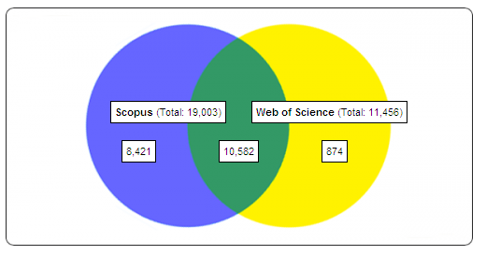
Broader coverage than nearest peer
19809
12311
8432
11377
934
“The Scopus surplus”
www.jisc-adat.com
August, 2013

Slide 9
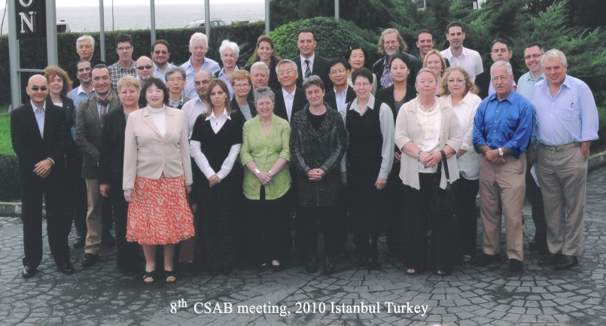
Scopus selection criteria a combination of quantitative and qualitative measures
Journal policy | English language abstracts available All cited references in Roman alphabet Convincing editorial concept/policy Level of peer-review Diversity in provenance of editors Diversity in provenance of authors
Quality of content | Academic contribution to the field Clarity of abstracts Conformity with journal’s aims & scope Readability of articles
Citedness | Citedness of journal articles in Scopus Citedness of editors in Scopus
Regularity | No delay in publication schedule
Accessibility | Content available online English-language journal home page Quality of home page
Eligibility
Peer-review
English abstracts
Regular publication
Statement on Publication ethics
50 Ukrainian journals in Scopus – 27 active (+4 since June)
http://info.scopus.com

Slide 10
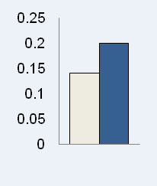
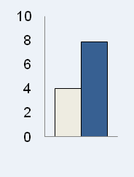
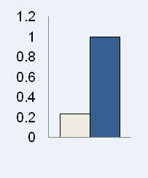
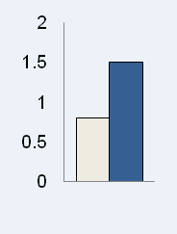
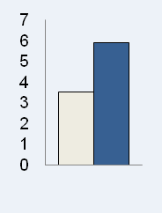
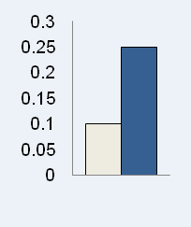
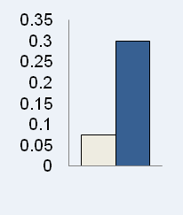
Breadth of coverage across geographical areas
Nearest competitor
Scopus
In Thousands
Wider coverage gives a more accurate picture of the research landscape
l

Slide 11

What about Books?
  Elsevier is planning to cover Books
    Currently covering Book series
  75.000 books will be covered by 2015
  Mainly Social Sciences, Arts and Humanities

Slide 12
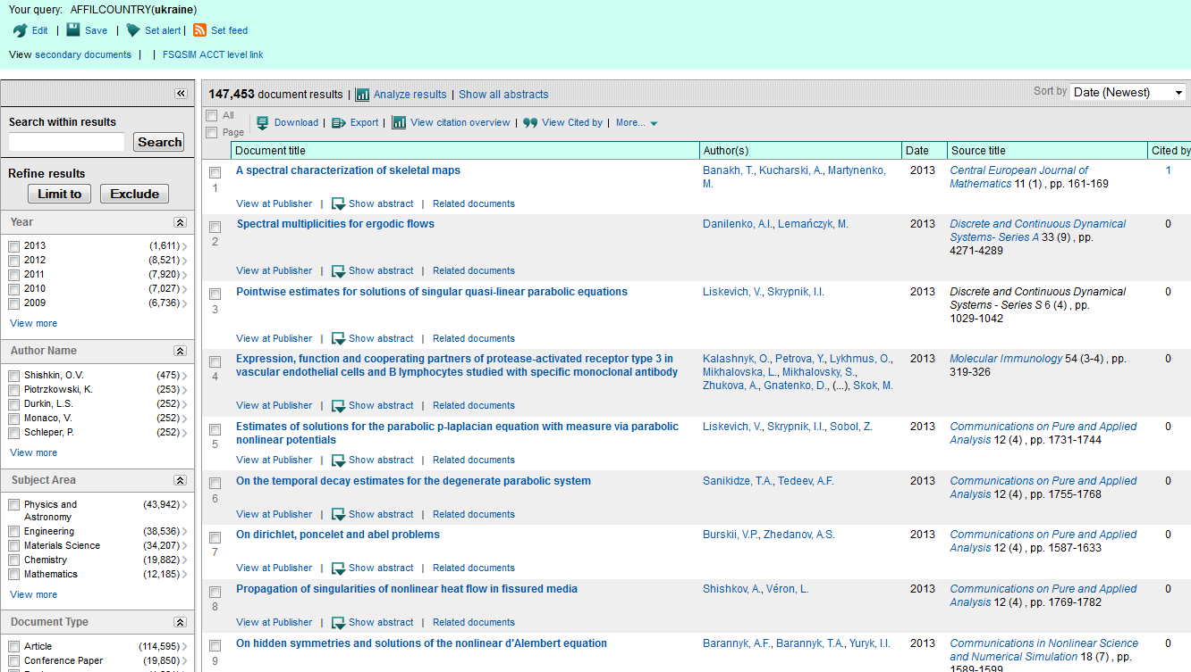
Easily find results and more...

Slide 13

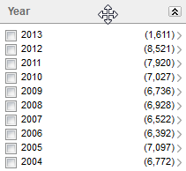
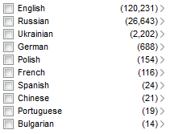
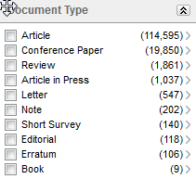
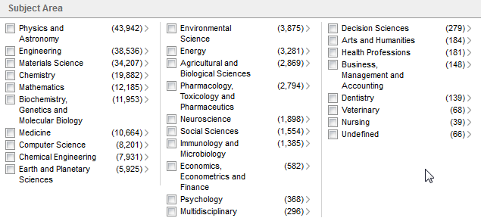
Scopus provides quick overview: Characteristics of Ukrainian output

Slide 14
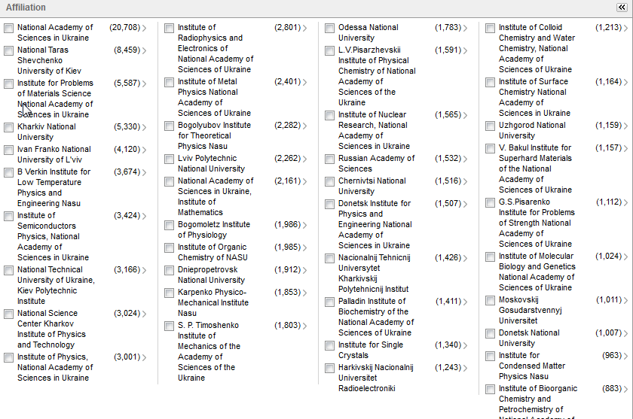
Top publishing Ukrainian institutions

Slide 15
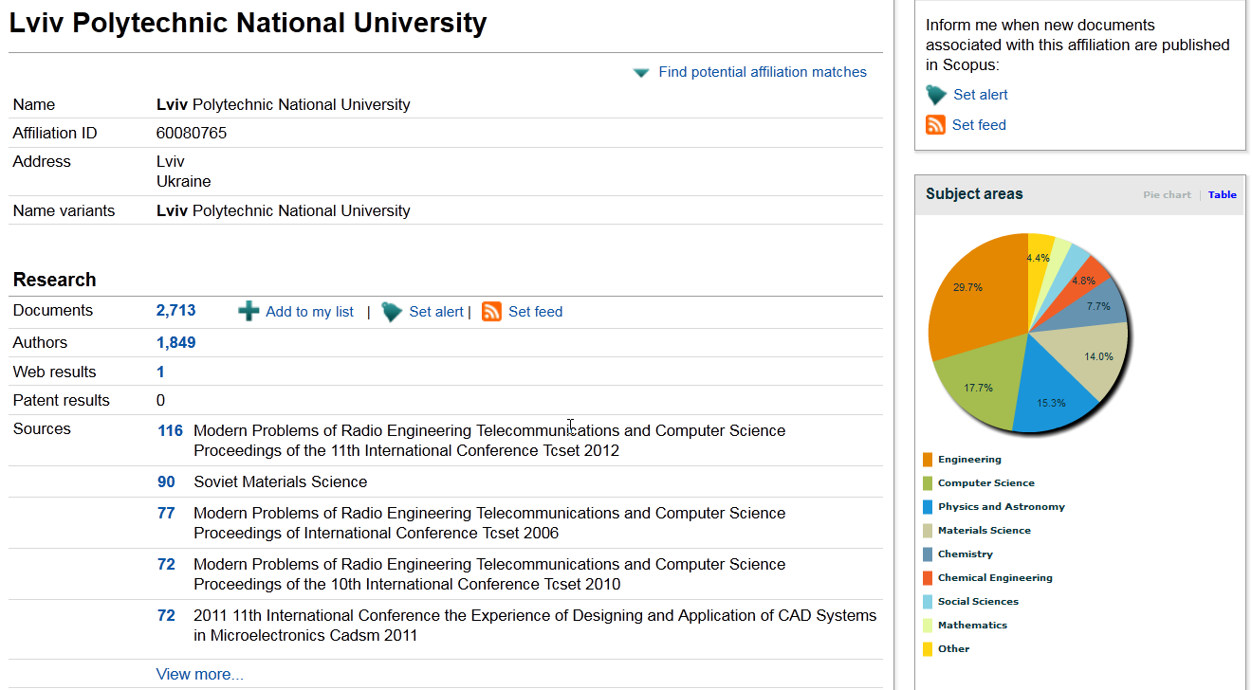
Scopus - affiliation profiling
Affiliation details include the affiliation ID, name variations, address information, research areas, documents published, sources the organization has published in, and collaborating affiliations.

Slide 16
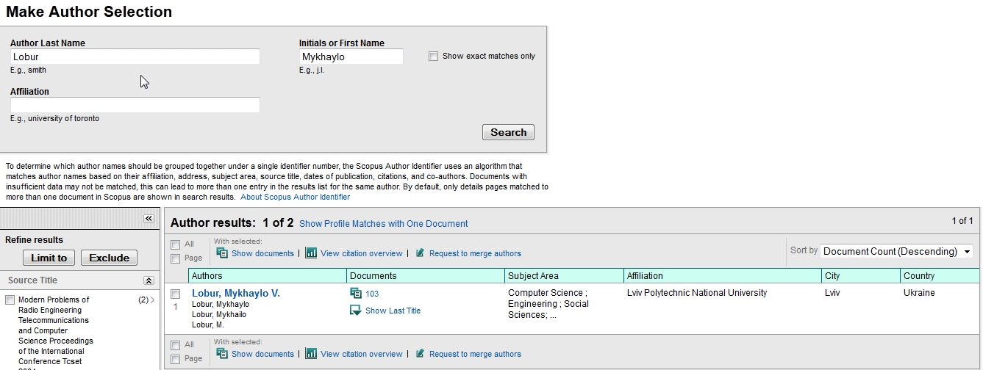
Scopus - author search results page
Results are listed in descending order by default.
Change the sorting order by selecting an option from the ‘sort by’ window
The Author’s name links to the ‘Author Details page

Slide 17
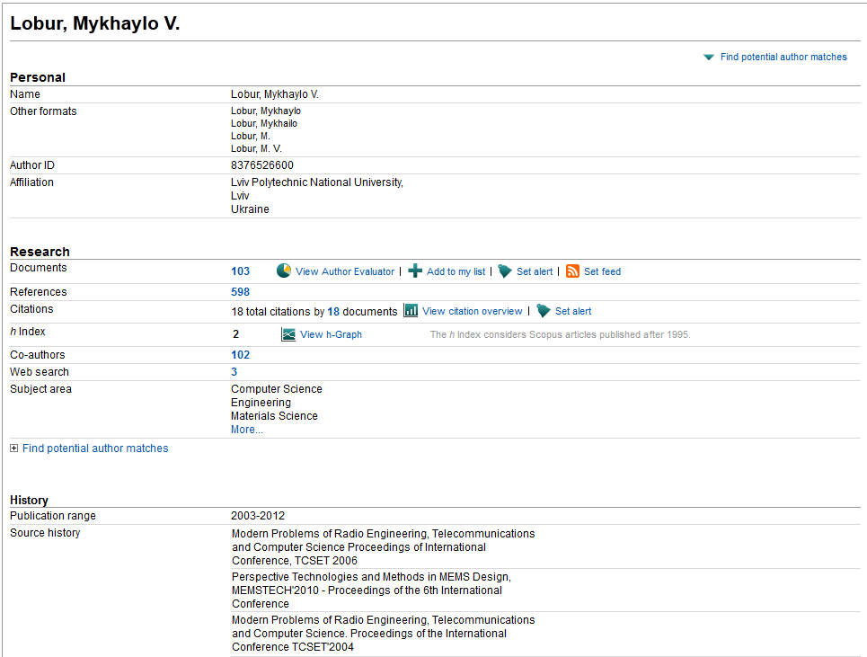
Scopus: author details page
The ‘Author details page gives links to (1) the author’s documents; (2) documents which are referenced by the author; (3) documents that have cited the author; (4) the Author details pages of all co-authors; (5) the results of searching the web using the author name
Use the ‘Find potential author matches’ for profiles which may be associated

Slide 18
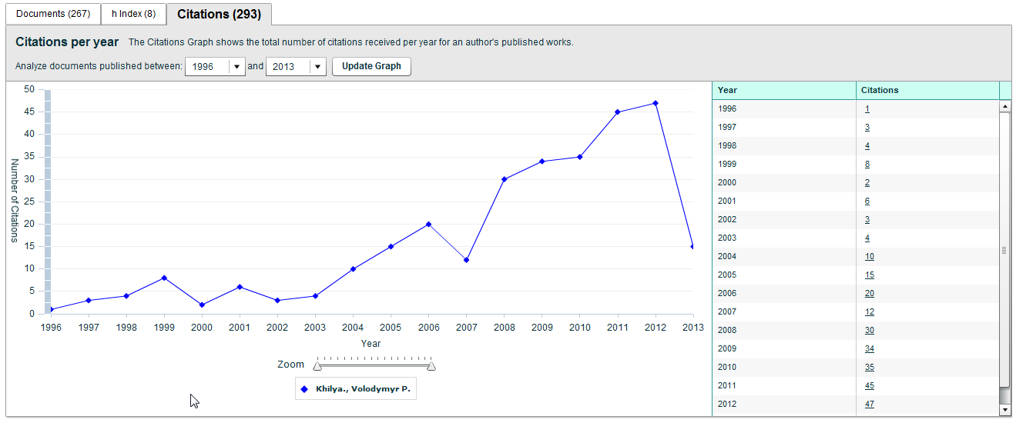
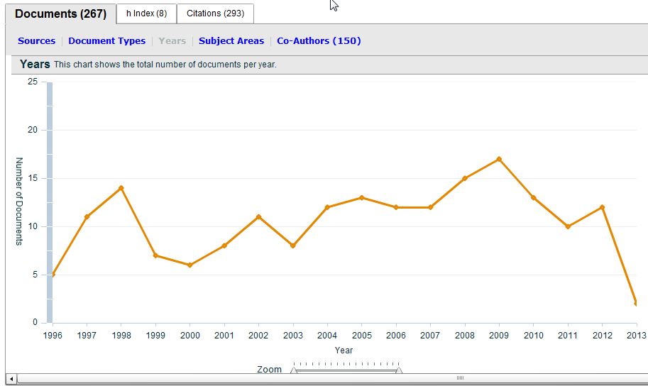
Citations – the measure of quality

Slide 19
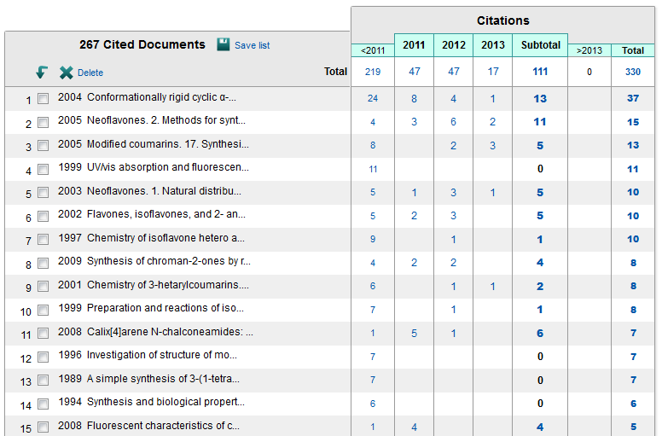
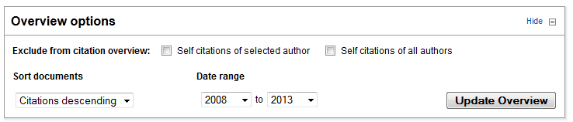
Scopus - citation tracker
You can include up to 5000 documents in a Citation Tracker. If you select more than 5000 documents only the first 5000 are included in the Citation Tracker

Slide 20
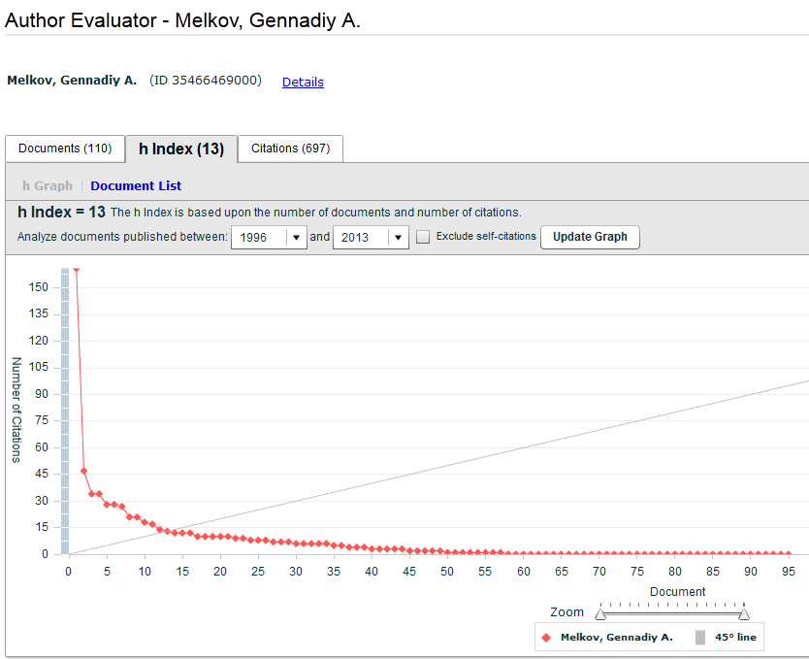
H-index
A scholar with an index of h has published h papers each of which has been cited by others at least h times
cited 13 times or more
13 papers

Slide 21


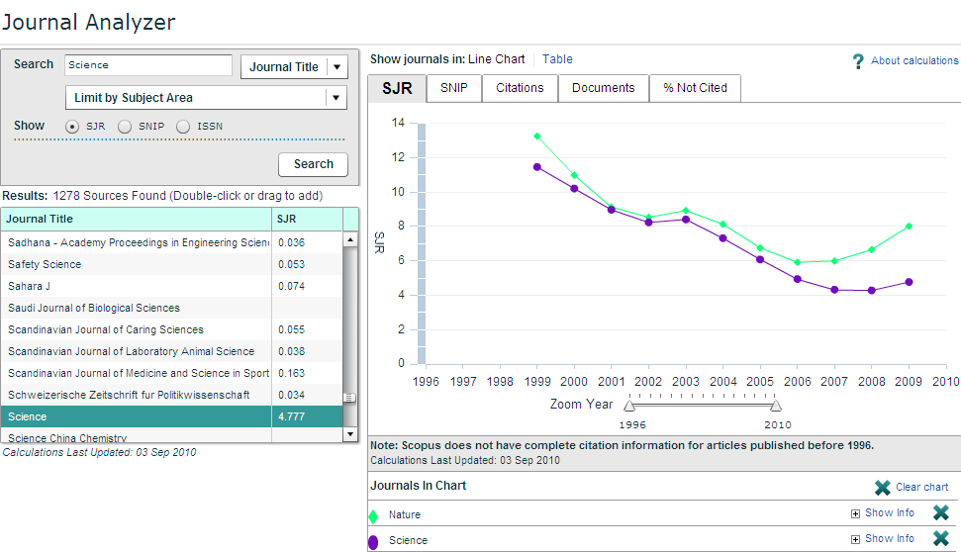
Scopus Analytics
Select the journal(s) you want to evaluate

Slide 22
Thank You!
Piotr Golkiewicz
Product Sales Manager for Central and Eastern Europe
p.golkiewicz@elsevier.com

